Slide 1

Using Whisper for automatic speech transcription
IMPRS Conference 2024 – June 6 & 7, 2024
Sho Akamine, Christina Papoutsi, Franziska Schulz
Max Planck Institute for Psycholinguistics

Slide 2
Table of contents
Introduction to Whisper
What is Whisper?
What is it useful for?
Limitations
Introduction to WhisperX
How long does it take to run Whisper?
Overview of the pipeline
Hands-on session

Slide 3
Overview of the pipeline

Slide 4




General framework
wav/mp4

Slide 5



General framework
WhisperX
wav/mp4
txt / TextGrid

Slide 6
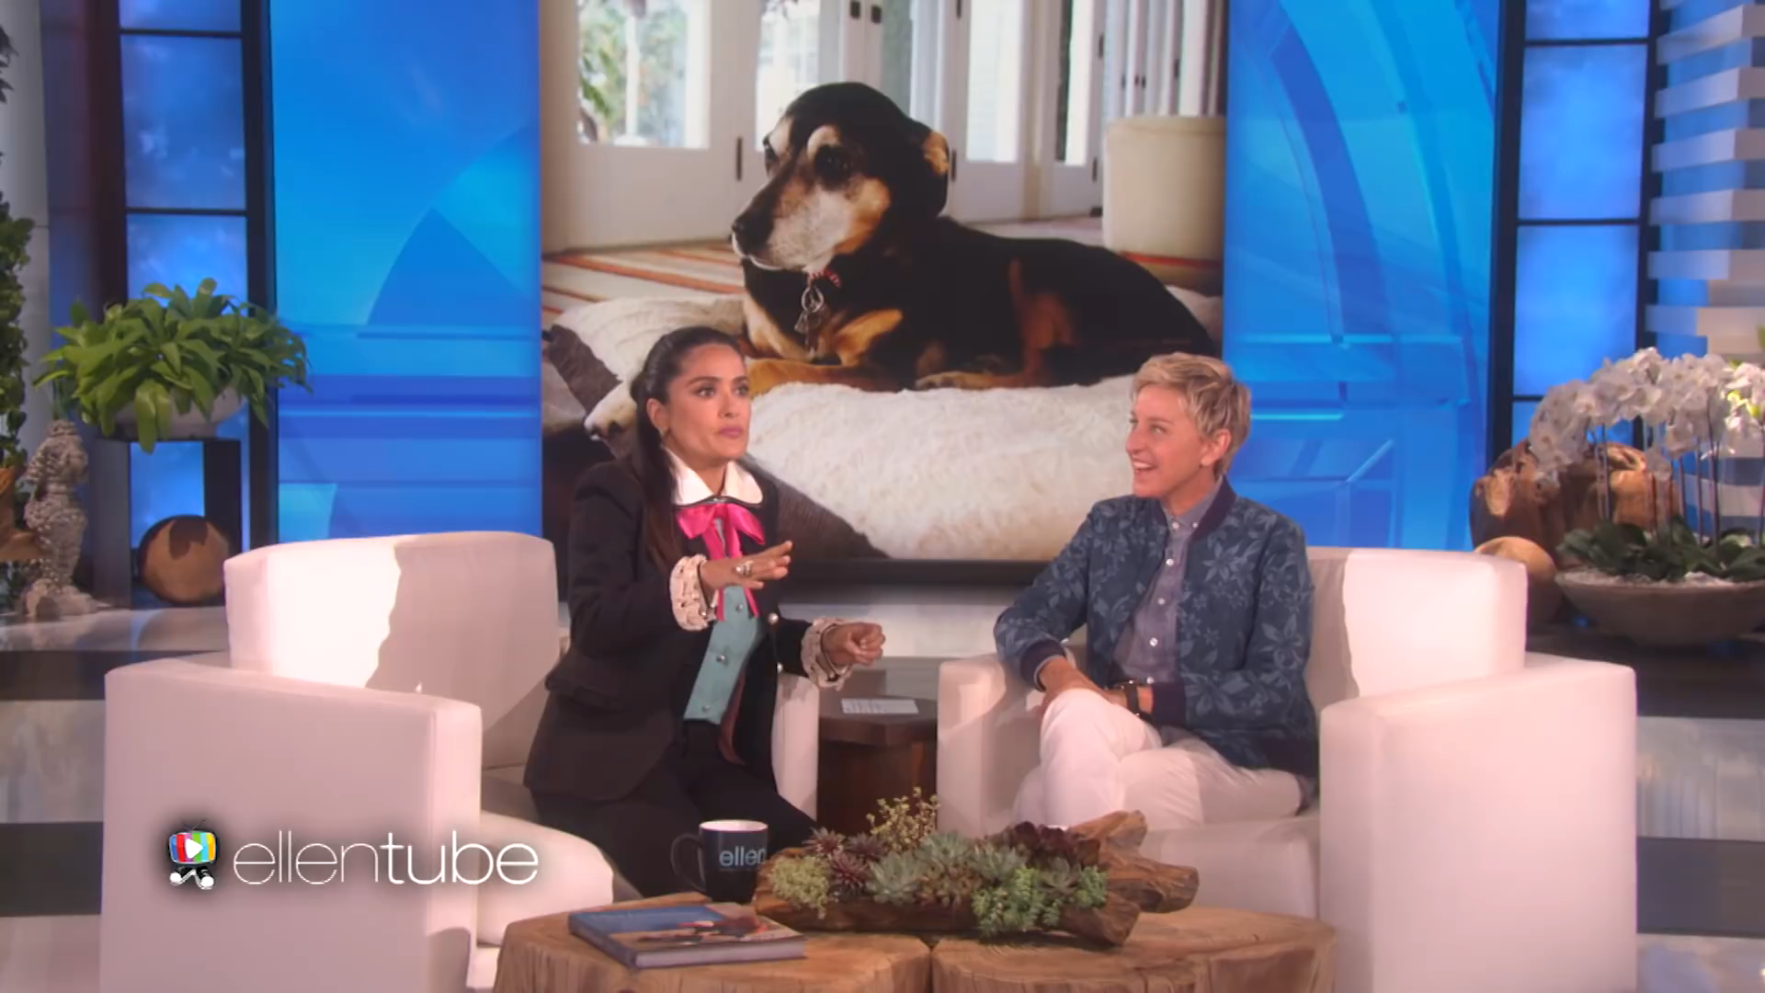
Example video file

Slide 7
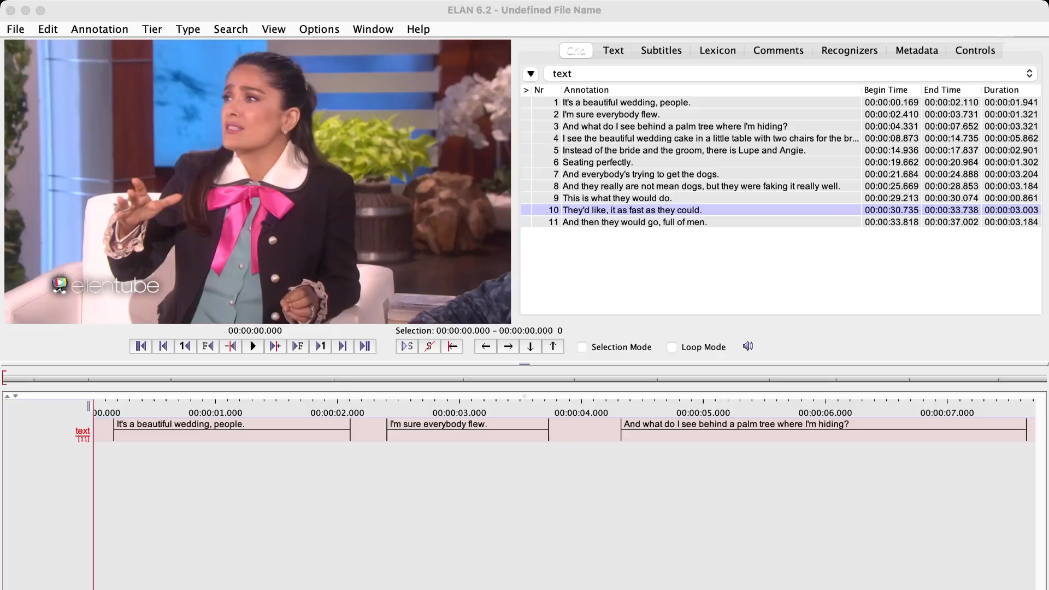
Example output (ELAN)

Slide 8
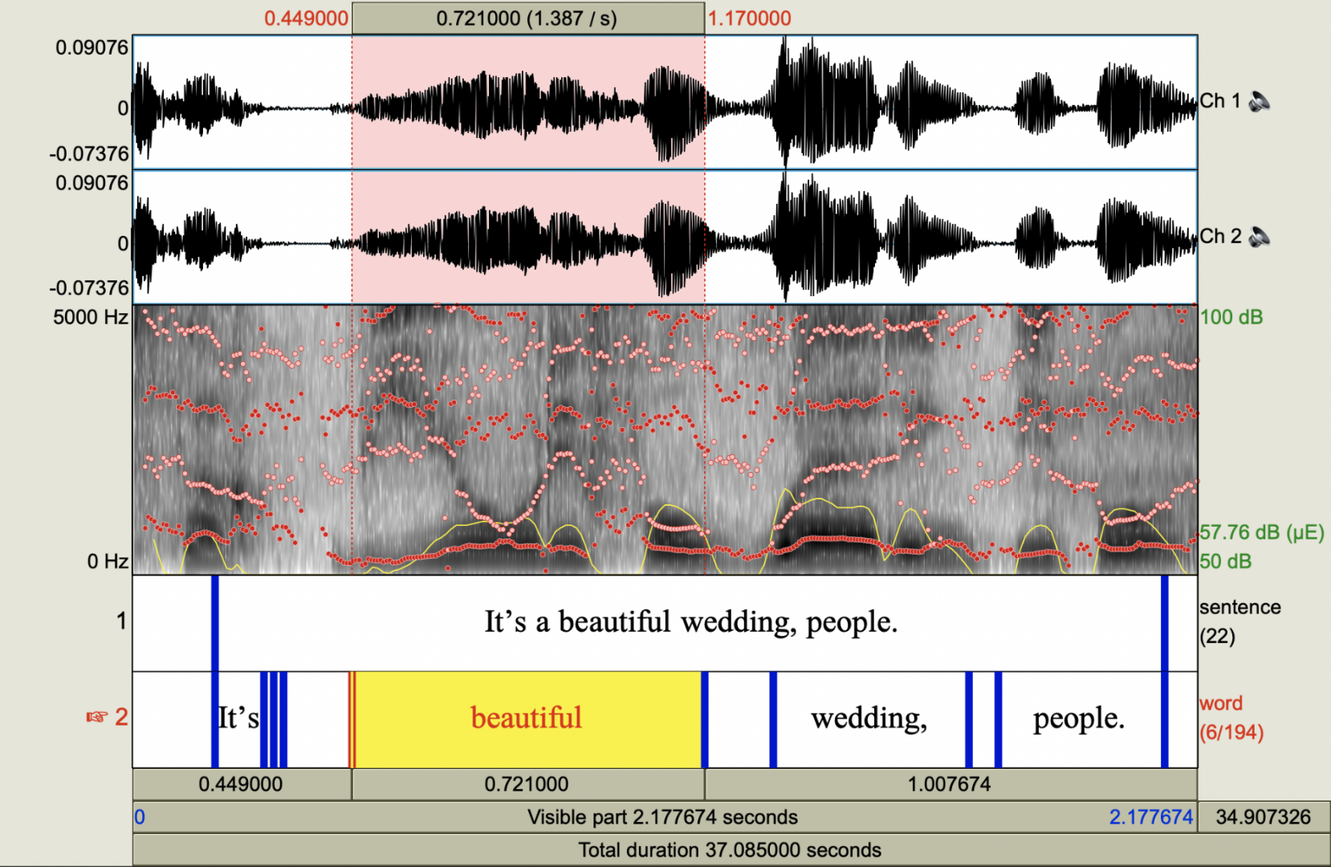
Example output (Praat) – WhisperX

Slide 9
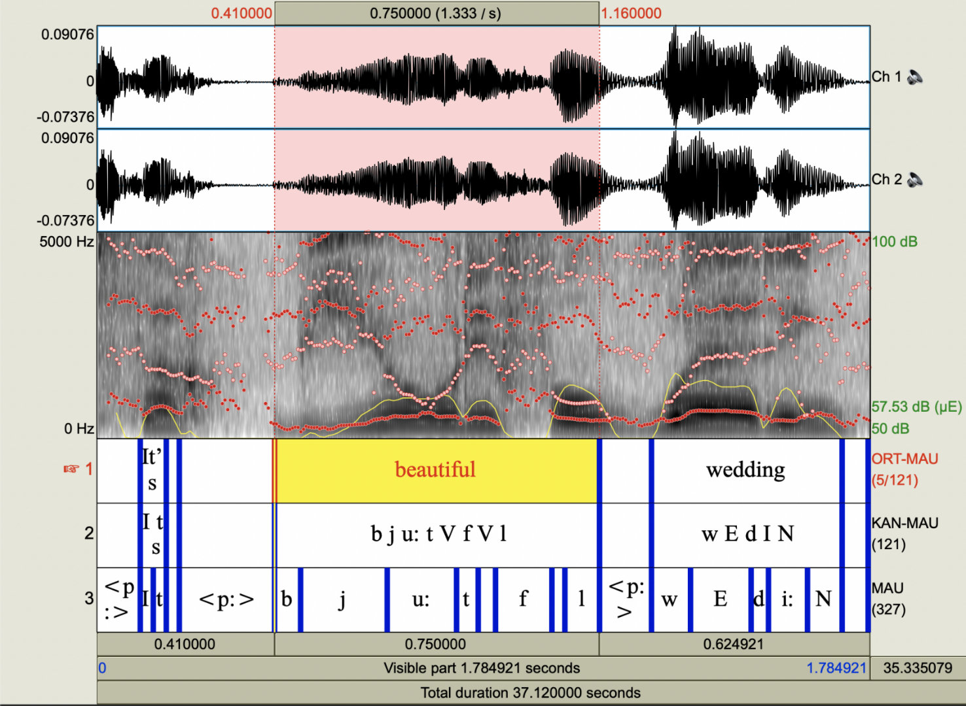
Example output (Praat) – WhisperX + WebMAUS

Slide 10
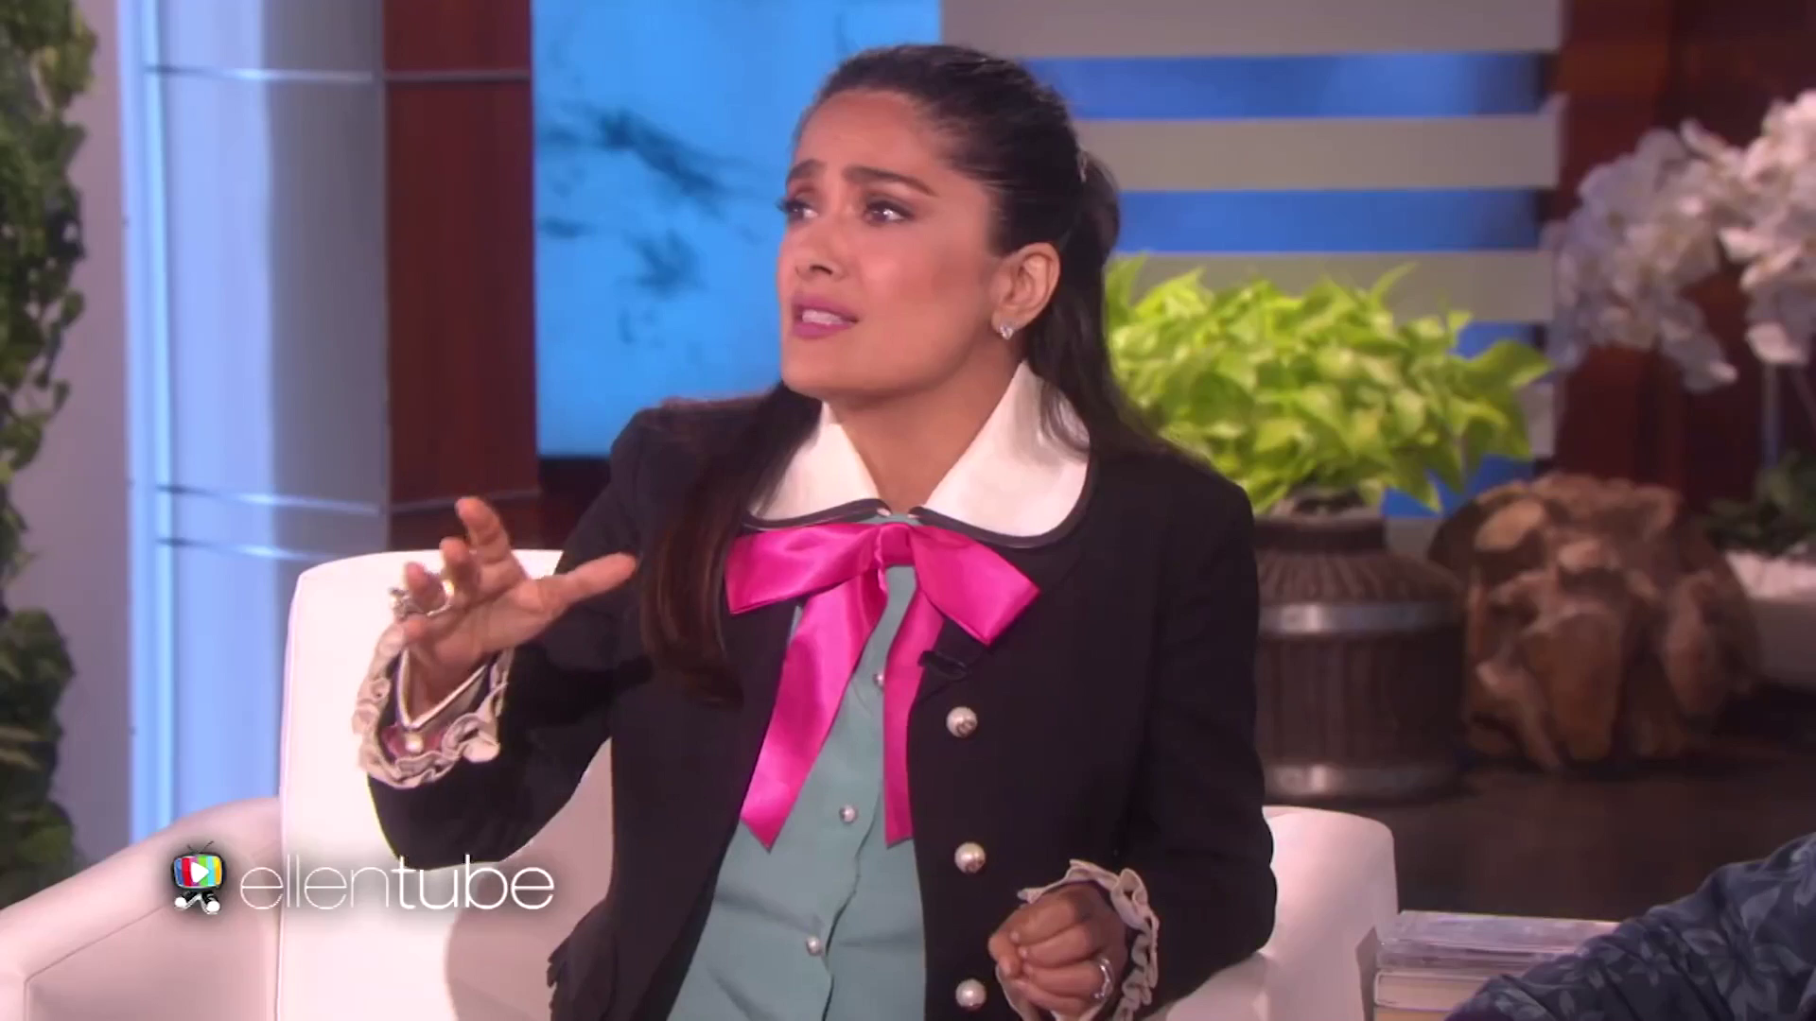
Example output (subtitles)

Slide 11
Introduction to Whisper

Slide 12
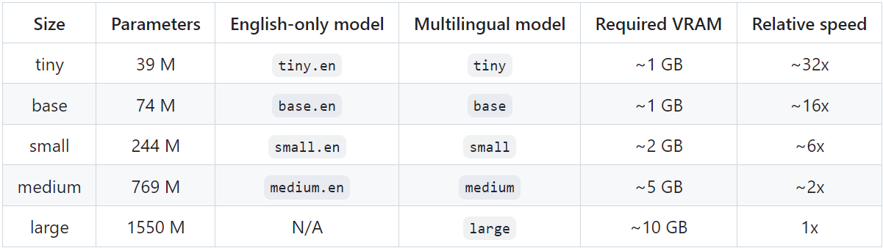


What is Whisper?
A general-purpose speech recognition model from OpenAI
Whisper can transcribe 100 different languages
Tends to be more accurate than other ASR models¹
Comes with 5 different model sizes²
Fast
Low accuracy
Slow
High accuracy
1. Radford et al. (2022); 2. https://github.com/openai/whisper/tree/main

Slide 13
What can we use Whisper for?
We can use Whisper to transcribe speech automatically
Save hours on speech transcription!!
Get annotation for sentence, word, and character levels (with WhisperX)
Get phonetic transcription (WhisperX + WebMAUS)
Transcribe languages you don’t speak (always have L1 speakers check)

Slide 14
What are the limitations?
Whisper isn’t perfect, and timestamps aren’t very accurate
Although transcription accuracy is high, it’s not perfect
→ Always check and revise the transcript
Whisper (or any ASR models) can’t handle speech overlaps well¹
→ Record each speaker separately (one file, one speaker)
Whisper (or any ASR models) don’t transcribe conversational words (e.g., backchannels, fillers)^{1,2}
Timestamps aren’t very accurate
→ Use WhisperX (optionally together with WebMAUS)
1. Liesenfeld, Lopez, & Dingemanse (2023); 2. Lopez, Liesenfeld, & Dingemanse (2022)

Slide 15
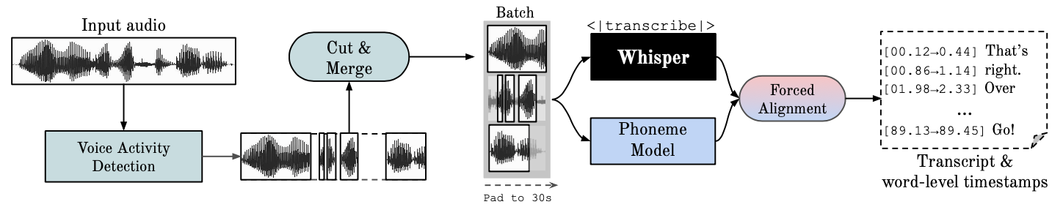
How to solve issues on inaccurate timestamps?
WhisperX offers more accurate timestamps and is faster!!
4-5 times faster than original Whisper
Provide accurate timestamps using wav2vec2 forced alignment
Provide annotation for sentence, word, and character levels
Bain et al. (2023)

Slide 16
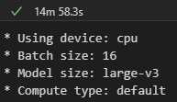
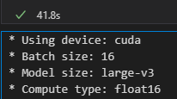
How long does it take for Whisper to transcribe speech?
Audio duration: 21m 38s
CPU only
CPU + GPU
CPU + GPU is more than 10x faster than CPU only!!

Slide 17
Is it safe to use?
Yes! (at least safer than other web-based platforms)
Runs locally (no need to upload video/audio files)
Other similar web-based platforms (e.g., WebMOUS) require you to upload media files
When in doubt, ask the data protection officer at your institute!

Slide 18
Summary
Whisper(X) can speed up the speech transcription for free!!

Slide 19
Hands-on session

Slide 20
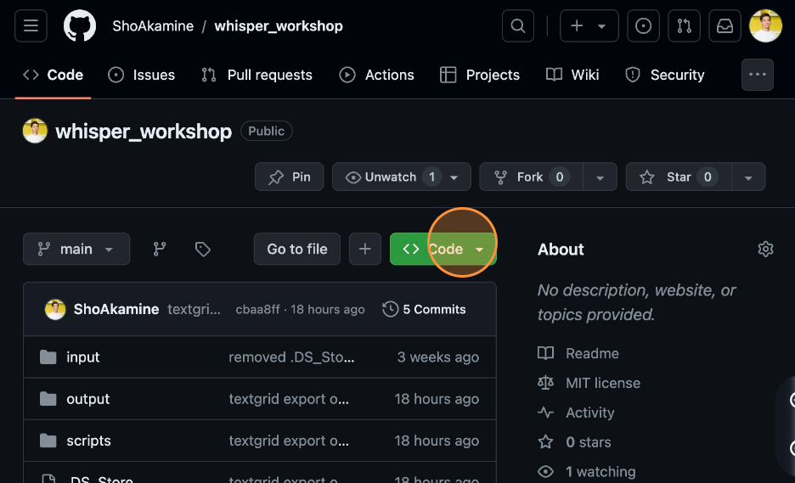
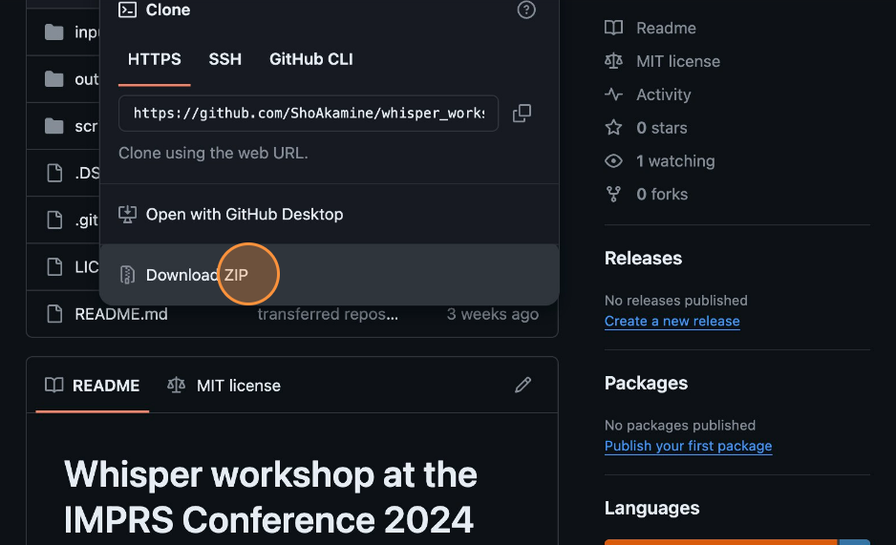
How to download the materials?
1
Navigate to https://github.com/ShoAkamine/whisper_workshop
2
Click “Code”
3
Click “Download ZIP”

Slide 21
How to download the materials?
4
Navigate to the downloads folder on your computer
5
Unzip the “whisper_workshop-main.zip” folder
6
Copy the “whisper_workshop-main” folder to the downloads folder

Slide 22
Folder structures
input folder contains media flies to be transcribed
Whisper output will be saved in the output folder
tsv folder: txt output files will be saved here
textgrid folder: TextGrid output files will be saved here
text_only folder: the txt files can be submitted to WebMAUS
srt folder: srt files (subtitles) will be saved here
json folder: unmodified WhisperX output object will be saved here
scripts folder contains python files and python notebook files
We will use “whisper.ipynb” notebook

Slide 23
Demonstration

Slide 24
Now, it’s your turn!!

Slide 25
References
Bain, M., Huh, J., Han, T., & Zisserman, A. (2023). WhisperX: Time-Accurate Speech Transcription of Long-Form Audio. INTERSPEECH 2023, 4489–4493. https://doi.org/10.21437/Interspeech.2023-78
Liesenfeld, A., Lopez, A., & Dingemanse, M. (2023). The timing bottleneck: Why timing and overlap are mission-critical for conversational user interfaces, speech recognition and dialogue systems. In S. Stoyanchev, S. Joty, D. Schlangen, O. Dusek, C. Kennington, & M. Alikhani (Eds.), Proceedings of the 24th Annual Meeting of the Special Interest Group on Discourse and Dialogue (pp. 482–495). Association for Computational Linguistics. https://doi.org/10.18653/v1/2023.sigdial-1.45
Lopez, A., Liesenfeld, A., & Dingemanse, M. (2022). Evaluation of Automatic Speech Recognition for Conversational Speech in Dutch, English and German: What Goes Missing? Proceedings of the 18th Conference on Natural Language Processing (KONVENS 2022), 135–143. https://aclanthology.org/2022.konvens-1.16
Radford, A., Kim, J. W., Xu, T., Brockman, G., McLeavey, C., & Sutskever, I. (2022). Robust Speech Recognition via Large-Scale Weak Supervision (arXiv:2212.04356). arXiv. https://doi.org/10.48550/arXiv.2212.04356

